Slide 1
R package Development
Environment:
R and Rstudio

Slide 2
Resources
https://cran.r-project.org/doc/manuals/R-exts.html#Creating-R-packages
http://r-pkgs.had.co.nz
http://www.mjdenny.com/R_Package_Pictorial.html
https://cran.r-project.org/doc/contrib/Leisch-CreatingPackages.pdf

Slide 3
R package Development
What is a R package
Writing your own packages
Publishing a package on CRAN

Slide 4
R package is
An extension of the R base system with code, data and documentation in standardized format

Slide 5
Lifecycle of R package development
Source
Bundled: a package that’s been compressed into a single file, i.e., .tar.gz.
Binary : A compiled version of a package with computer-readable format, platform specific
Installed: a binary package decompressed into a package library
in-memory
devtools::build()
devtools::build(binary = TRUE)
devtools::install() / devtools::install_github()
library() or require()
https://win-builder.r-project.org/upload.aspx

Slide 6
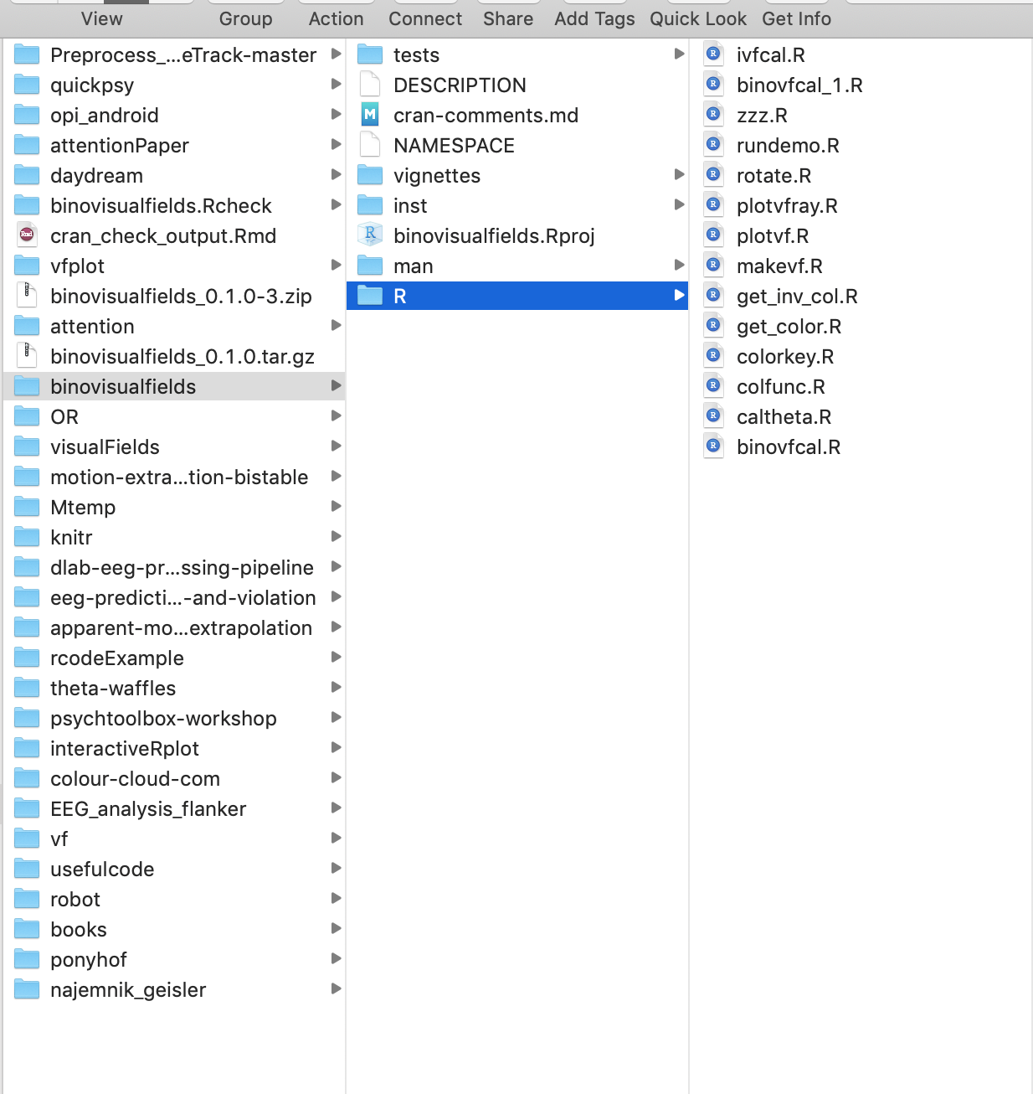
Basic structure of a package in development

Slide 7
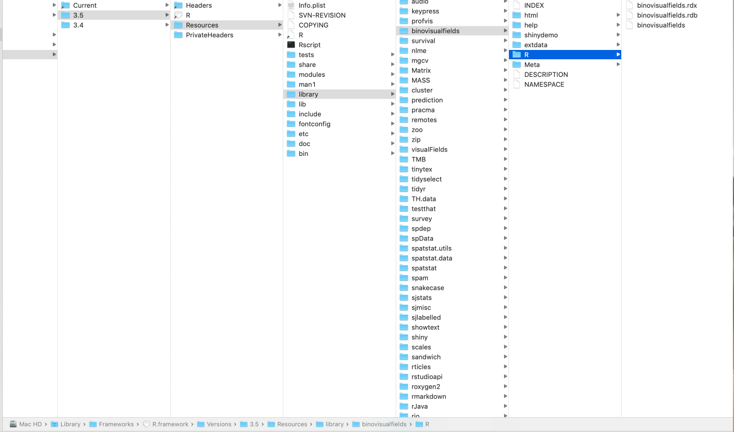
Basic structure of an installed package

Slide 8
Basic structure of a package in development

Slide 9
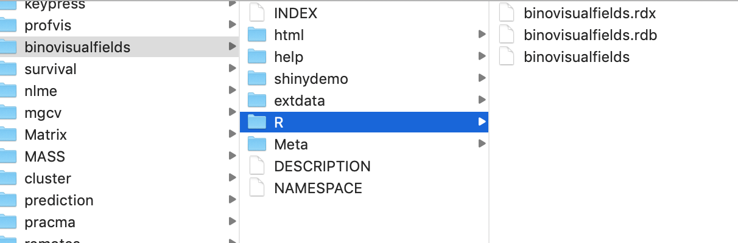
Basic structure of an installed package

Slide 10
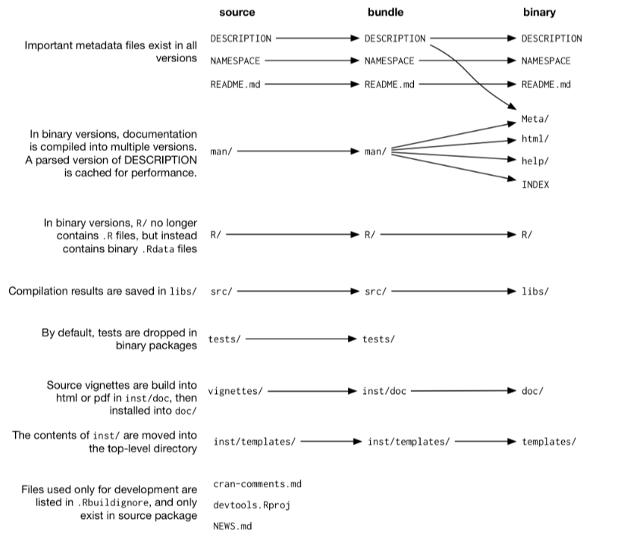
Files
in
source bundled
binary

Slide 11
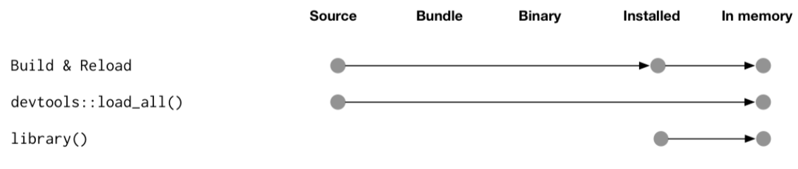
Lifecycle of R package development
devtools::load_all() Ctrl/Cmd + Shift + L

Slide 12
Essential packages
install.packages(c("devtools",
"roxygen2",
"testthat",
"knitr"))

Slide 13
Challenges
Unit tests – graphical output of functions
Constant variable
Changing default parameters
rundemo function
Shiny
Citation

Slide 14
Unit tests – graphical output of functions
visualTest (devtools::install_github("MangoTheCat/visualTest")
Vdiffr: ggplot2 figures

Slide 15
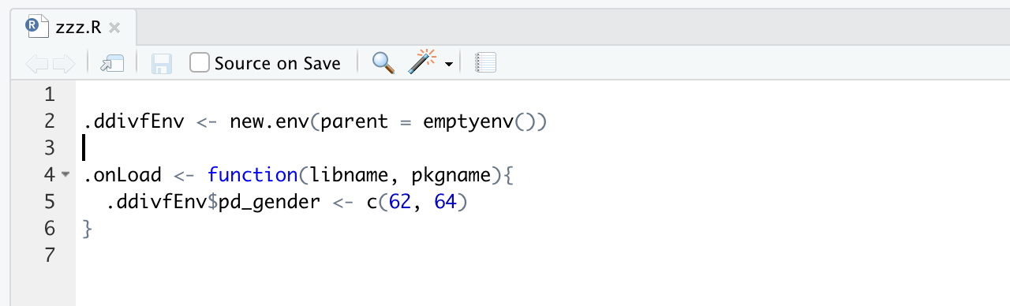
Constant values: the zzz.R file
Constant values are stored in zzz.R file by convention

Slide 16
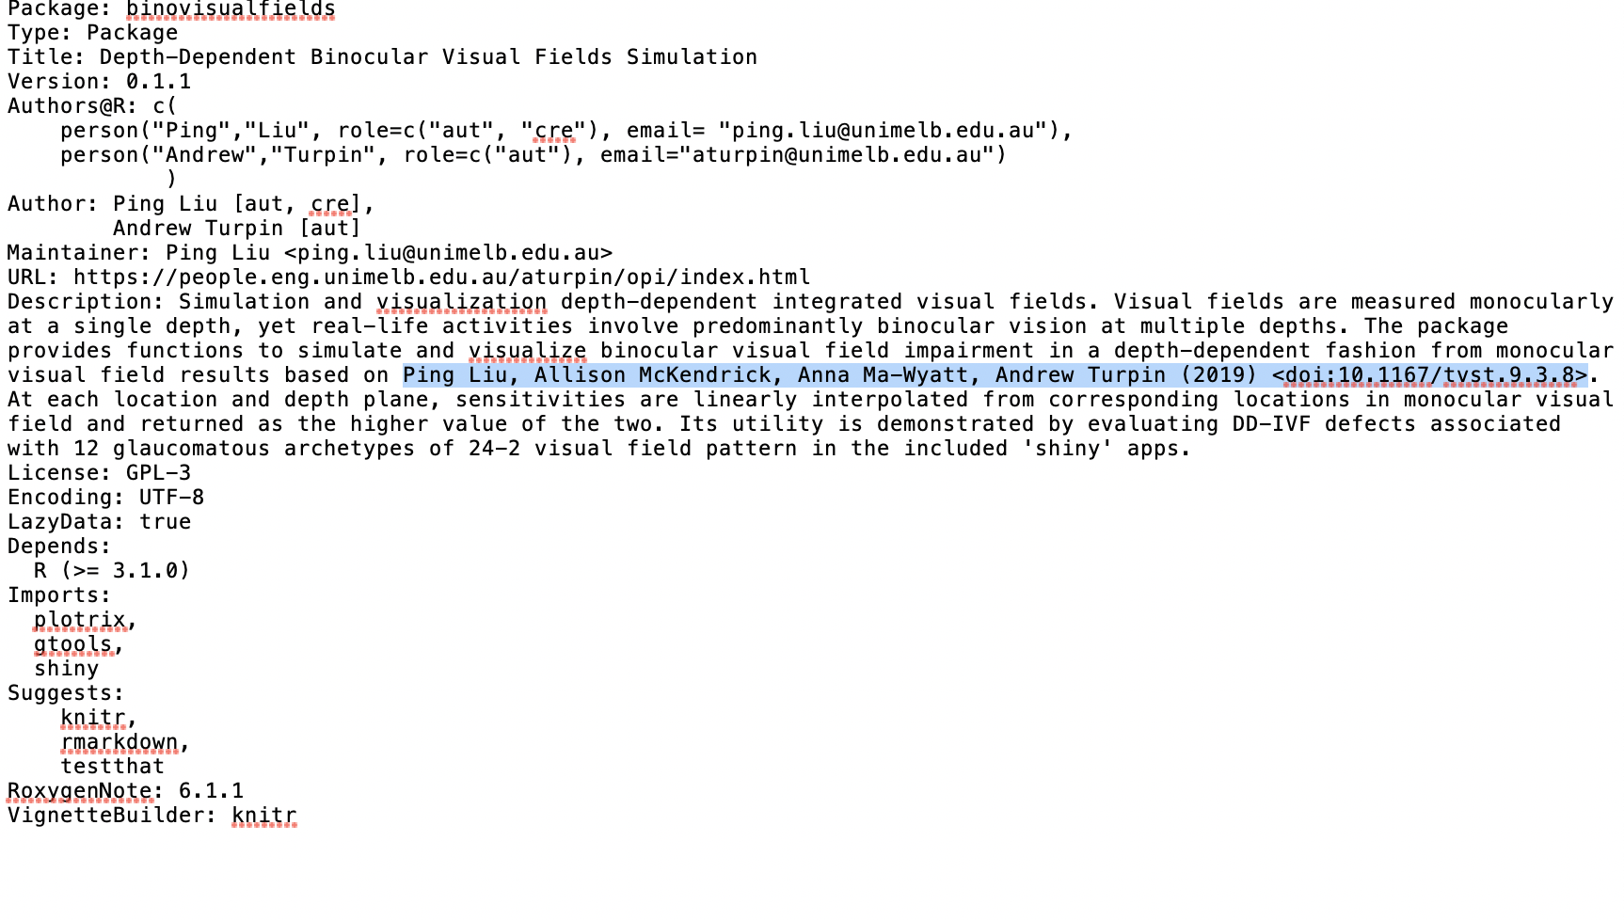
Description file & Citation

Slide 17
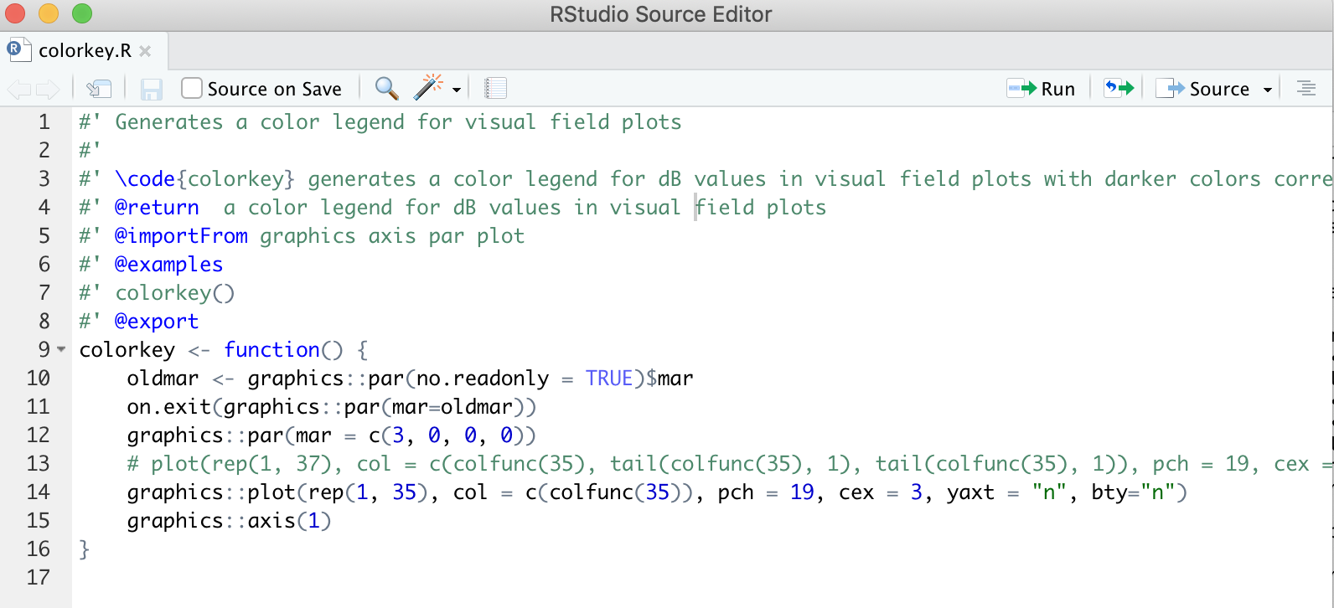
Changing default parameters

Slide 18
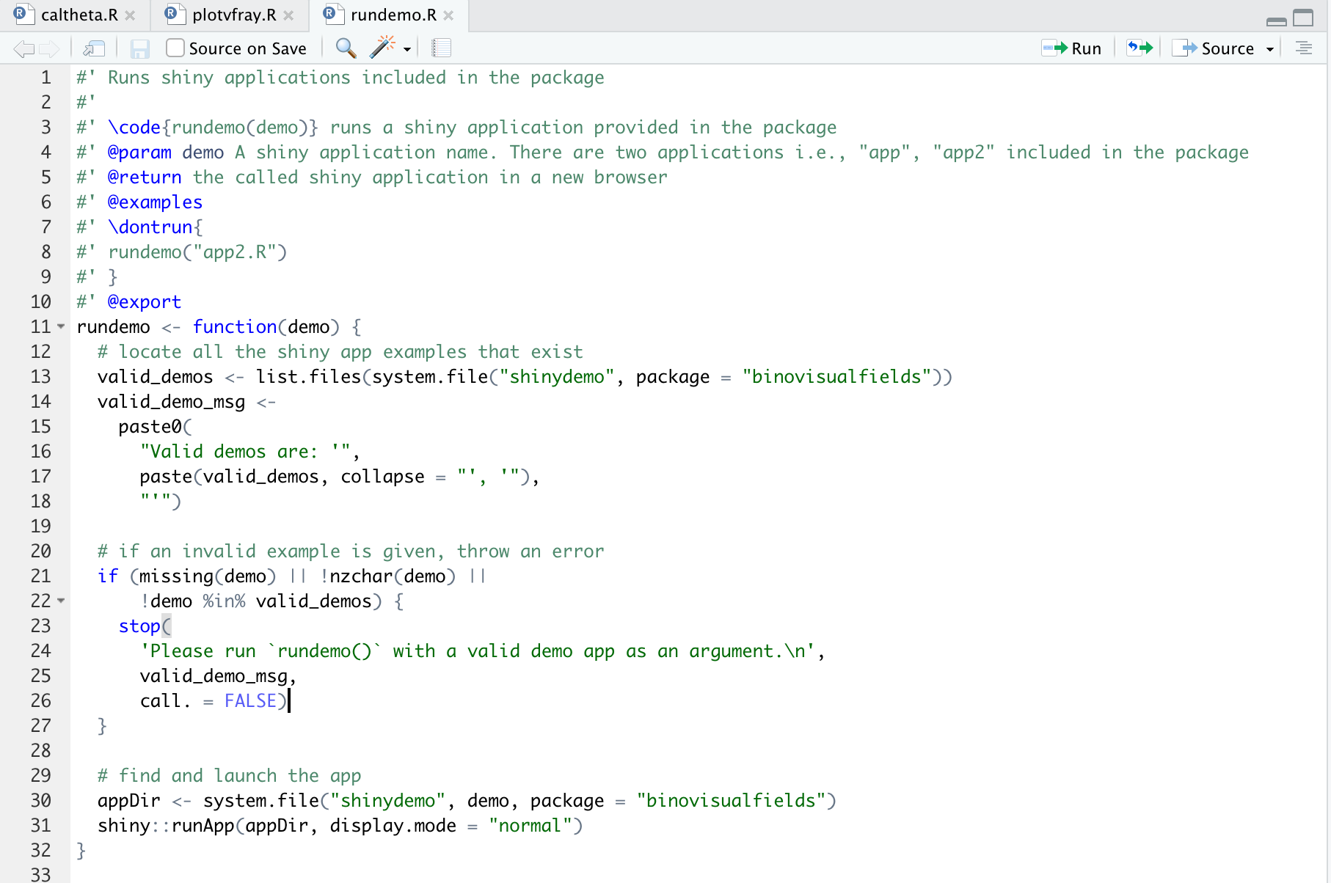
rundemo.R

Slide 19
Shiny app speed issue
Shiny package run on your computer vs. server
Clarity of the logic of code vs. Speed

Slide 20
Structure
R directory
Description file
Documenting
Vignettes
Unit tests
NAMESPACE file
data directory
inst directory
src
demo
exec
po
tools
classes, generics and methods

Slide 21
Package Naming
Informative for what the package does
Find it easily with Google
Check if the name has been used
No mixing of both upper- and lower-case letters

Slide 22
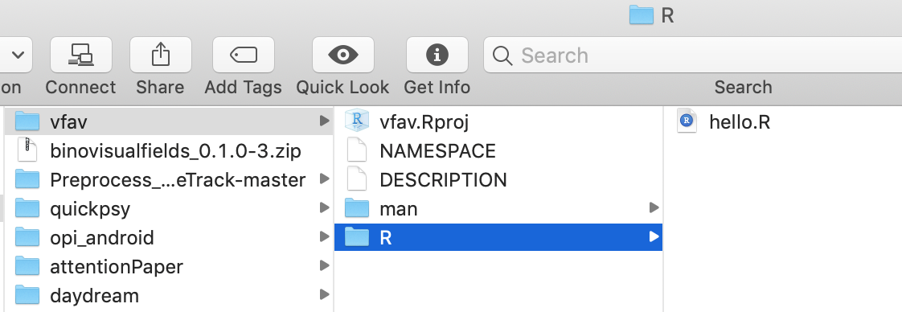
R directory
devtools::create("path/to/package/pkgname")
all R code goes in R/
devtools::load_all() / Ctrl/Cmd + Shift + L

Slide 23
Function organization
Don’t put all functions into one file
Don’t put each function into its own separate file I did

Slide 24
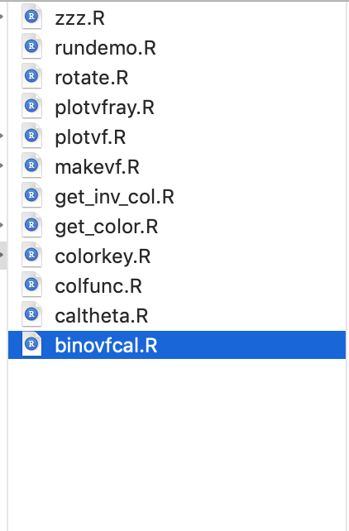
Function Naming
Informative for what the function does
No mixing of both upper and lower case letters
end in .R
Variable and function names should be lowercase
use underscore (_) to separate word
variable names should be nouns and function names should be verbs

Slide 25
Function style
Spacing
Curly braces
Line length
Indentation
Assignment
Commenting guidelines

Slide 26
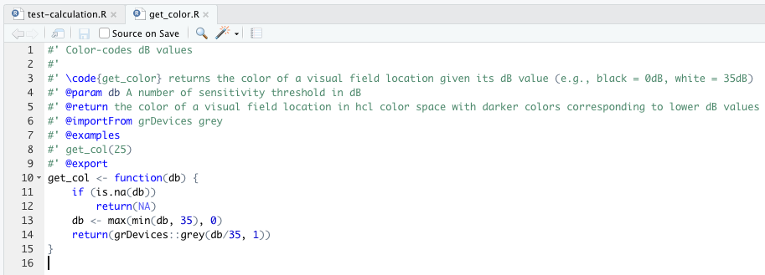
Function file example

Slide 27
Function file
When the package is built (e.g. by CRAN) all the code in R/ is executed and the results are saved.
package code should only create objects, mostly functions.
library()
options()
setwd()
require()
clean up with on.exit()
Don’t change the R landscape
Never use source()
global options() or graphics par()

Slide 28
DESCRIPTION file
Compulsory
Store important metadata
devtools::create("mypackage")
Debian control format
Consists of a field name and a value, separated by a colon
Multiple lines need to be indented

Slide 29
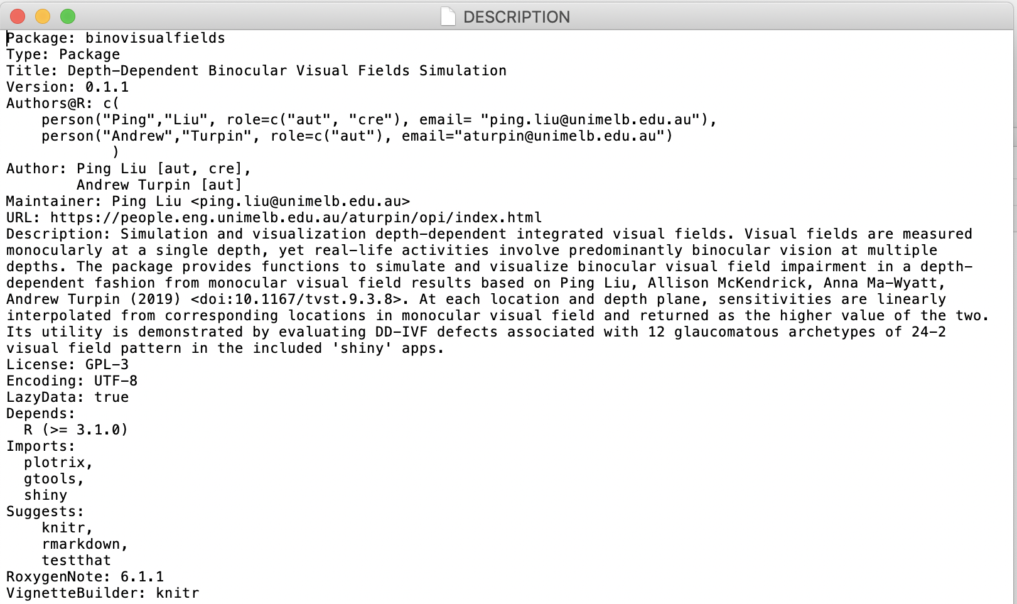
An example of DESCRIPTION file

Slide 30
DESCRIPTION file
Depends: loads and attach the package functions
Imports: packages listed here must be present for your package
Suggests: your package can use these packages, but doesn’t require them.
Title: one line description of the package. use plain text, capitalised like a title, and NOT end in a period.
Authors@R: person("Hadley", "Wickham", email = "hadley@rstudio.com", role = c("aut", "cre"))
devtools::use_package("dplyr") # Defaults to imports
devtools::use_package("dplyr", "Suggests")

Slide 31
Use function from other packages

Slide 32
DECRIPTION file
Depends loads and attach the package functions, only R (>= 3.1.0)
Import only loads the package functions
Almost always use Imports to avoid any function name masking issues.
attaching and .onAttach
thus means that a package is attached to the user space
aka the global environment
usually this is done via library(pkg)
and you can use normal fun() syntax
loading and .onLoad
thus means that package is (in any way) made available to the current R-session
(e.g. by loading/attaching another package that depends on it or by using pkg::fun()syntax the first time)
though you will not find functions in the global environment
you can use pkg::fun()

Slide 33
Documenting functions - roxygen2
man/ directory .Rd files (can be manually written it)
Use roxygen2 in .R files which turns specially formatted comments into .Rd files
#’
#’ \code{function_name}
#’ @param
#’ @return
#’ @importFrom
#’ @examples
#’ @section
#’ @export
#’ @section (Warning: )
devtools::document() | Ctrl/Cmd + Shift + D

Slide 34
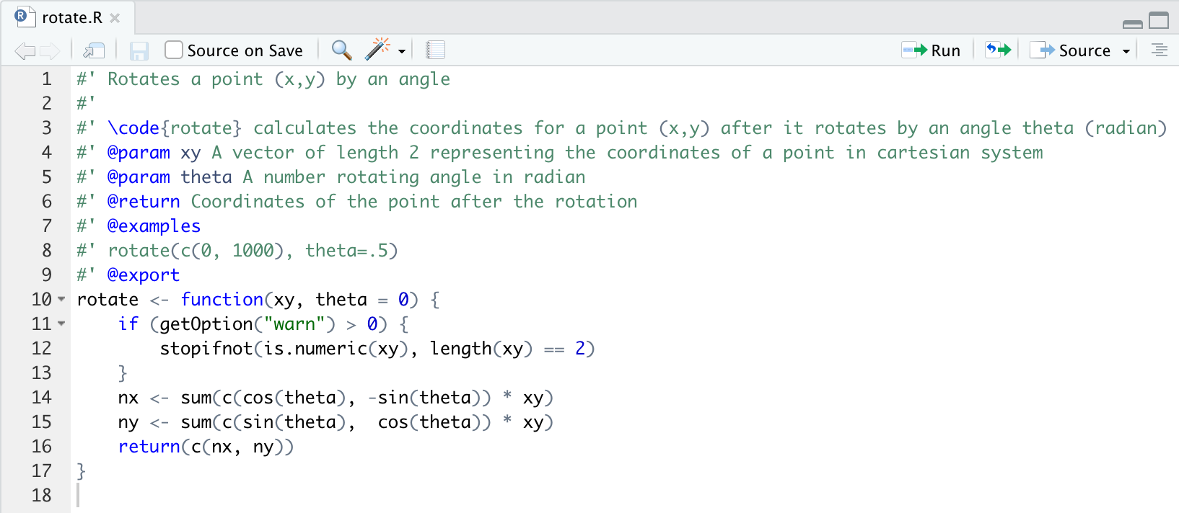
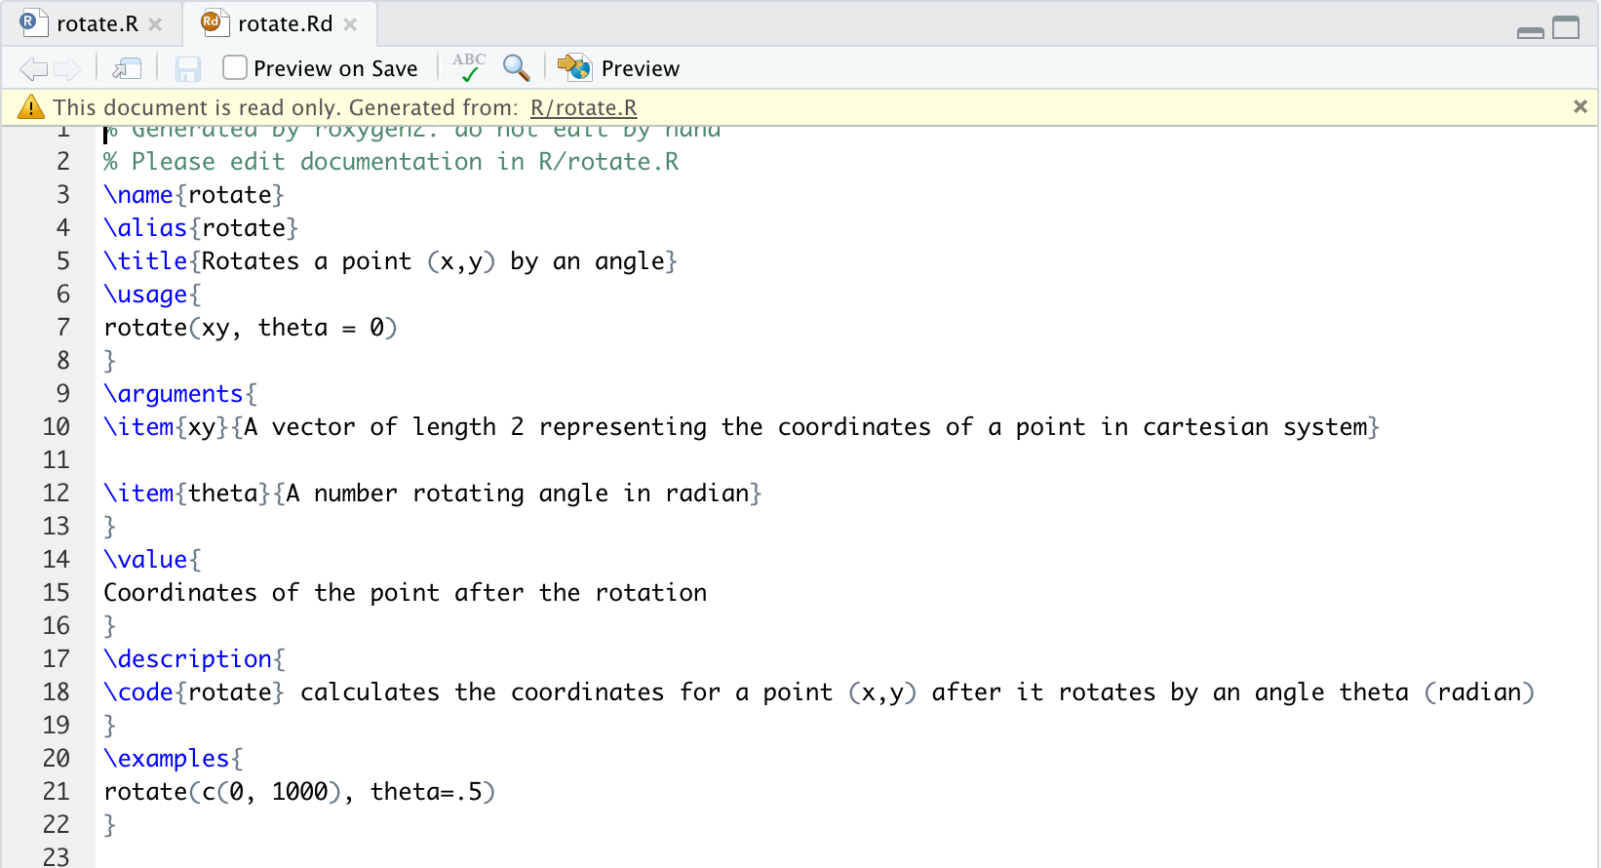
Documenting functions - roxygen2

Slide 35
Documenting functions - roxygen2
Special characters:
@, which usually marks the start of a roxygen tag. Use @@ to insert a literal @ in the final documentation.
%, which usually marks the start of a latex comment which continues to the end of the line. Use \% to insert a literal % in the output document.
\, which usually marks the start of a latex escaping. Use \\ to insert a literal \ in the documentation.

Slide 36
Documenting functions - roxygen2

Slide 37
Vignettes- Rmarkdown & knitr
A vignette is a long-form guide to your package.
A vignette is like a book chapter or an academic paper: it can describe the problem that your package is designed to solve, and then show the reader how to solve it.
A vignette should divide functions into useful categories and demonstrate how to coordinate multiple functions to solve problems.
Each vignette provides three things:
the original source file,
a readable HTML page or PDF,
and a file of R code.

Slide 38
Vignettes- Rmarkdown & knitr
devtools::use_vignette("my-vignette")
Create a vignettes/ directory.
Add the necessary dependencies to DESCRIPTION (i.e. it adds knitr to the Suggests and VignetteBuilder fields).
Draft a vignette, vignettes/my-vignette.Rmd.

Slide 39
Vignettes- Rmarkdown & knitr
Metadata
---
title: "Vignette Title”
author: "Vignette Author”
date: "`r Sys.Date()`”
output: rmarkdown::html
vignette vignette: >
%\VignetteIndexEntry{Vignette Title}
%\VignetteEngine{knitr::rmarkdown}
\usepackage[utf8]{inputenc}
---

Slide 40
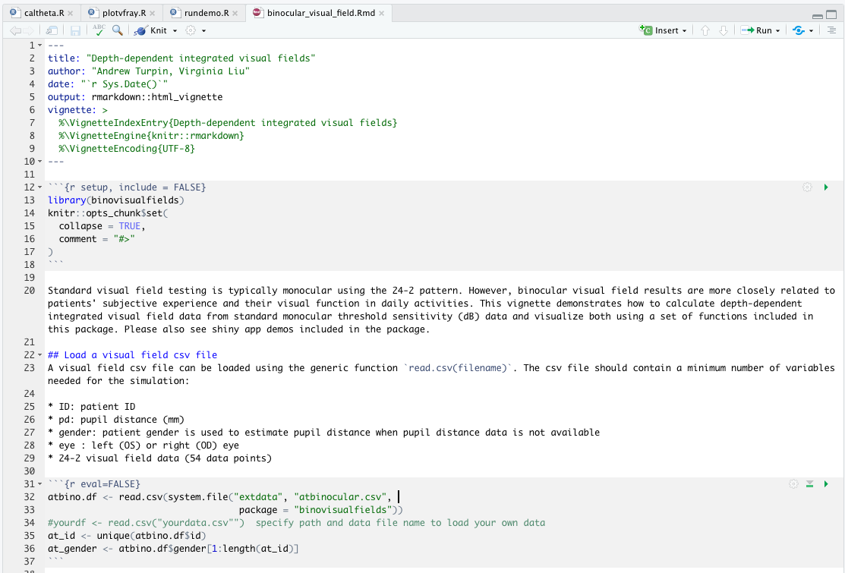
Vignettes - Rmarkdown & knitr

Slide 41
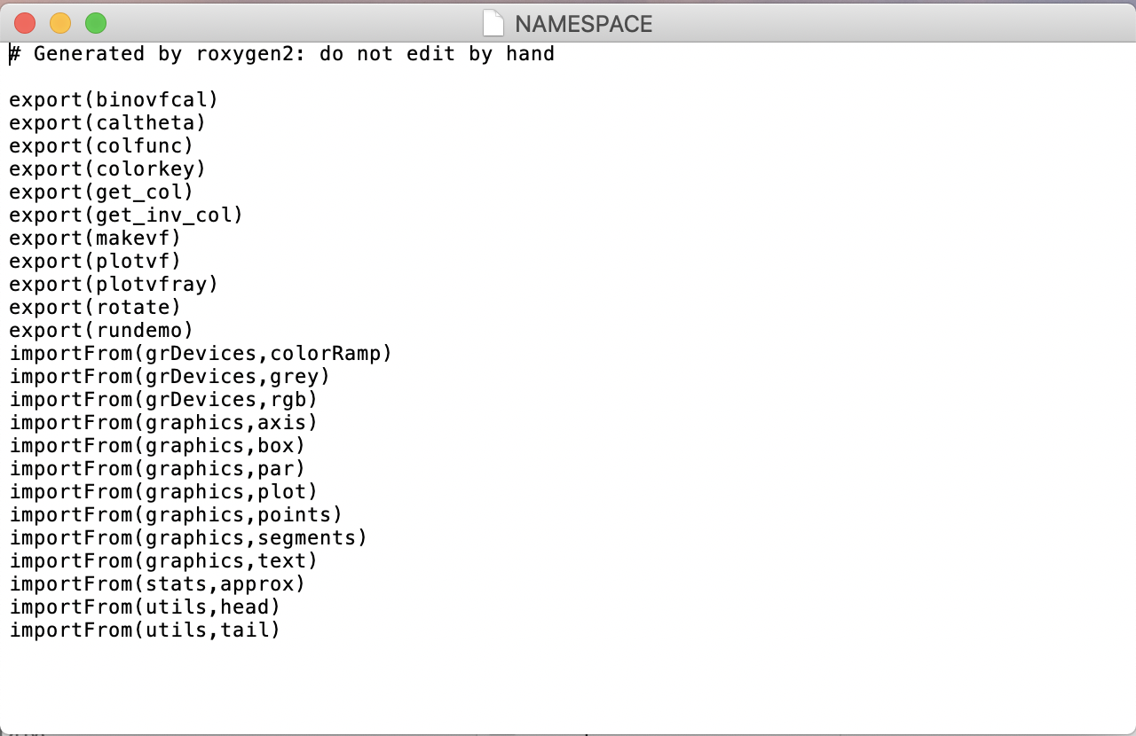
NAMESPACE file

Slide 42
Data
data/ datasets included in the package
inst/ miscellaneous other stuff
.rda or .Rdata
.csv .text

Slide 43
Constant: the zzz.R file
Constant values are stored in zzz.R file by convention
Notes:
When you want to modify the environment, in this case provide some constant values, the convention is to put in a file called zzz.R file

Slide 44
Unit tests
Robust code
Will not break easily upon changes ( e.g, new R version, package updates, bug fixes, new features, etc.)
Can be refactored simply
Can be extended without breaking the rest
Can be tested

Slide 45
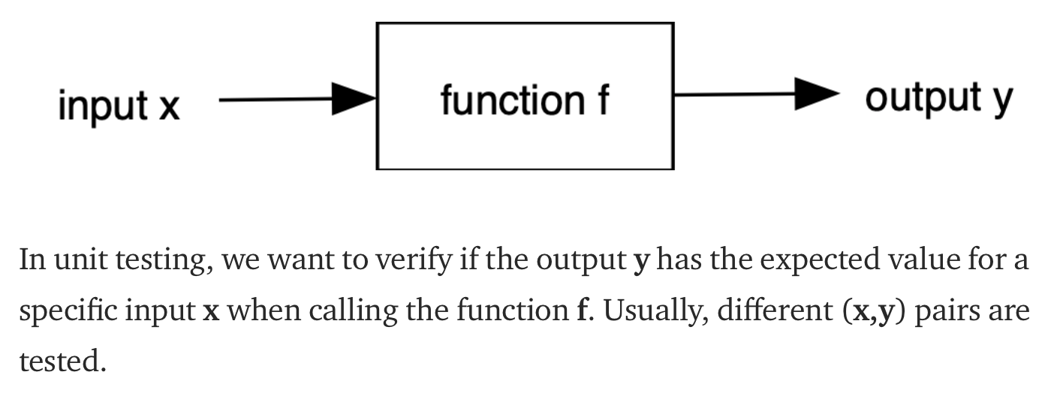
Unit tests – testing simple functions
Functions with side effects (database, file, hardware I/O, Classes)

Slide 46
Unit tests – usethis – testthat
devtools::use_testthat()
usethis::use_testthat()
Ctrl/Cmd + Shift + T
Check testthat package is actually installed in your R. It is listed in the Suggests field not Imports field in the DESCRIPTION file of usethis package
Notes:
This is weird but devtools installation will install usethis but testthat is listed under suggests not imports field so usethis wont install testthat. So make sure you install it.

Slide 47
Unit tests – usethis – testthat
An expectation is the atom of testing. Expectations are functions that start with expect_.
A test groups together multiple expectations. A test is created with test_that() .
A file groups together multiple related tests. Files are given a human readable name with context().
The contents of the tests directory are written into source-distribution packages, but not written into binary-distribution packages.
Notes:
An expectation is the atom of testing. It describes the expected result of a computation: Does it have the right value and right class? Does it produce error messages when it should? Expectations are functions that start with expect_.
A test groups together multiple expectations to test the output from a simple function, a range of possibilities for a single parameter from a more complicated function, or tightly related functionality from across multiple functions. This is why they are sometimes called unit as they test one unit of functionality. A test is created with test_that() .
A file groups together multiple related tests. Files are given a human readable name with context().
The contents of the tests directory are written into source-distribution packages, but not written into binary-distribution packages.

Slide 48
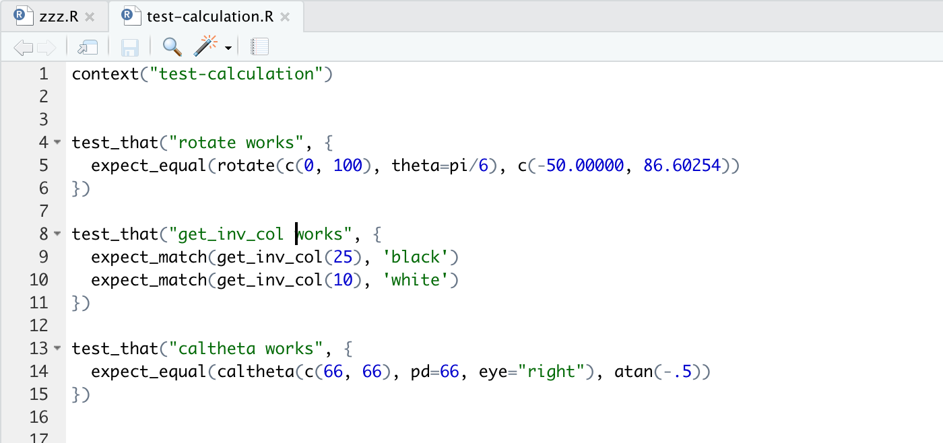
Unit tests
Notes:
Test files look like this. The basic unit is expect_equal(), the building block is test_that, all building blocks are put in a context

Slide 49
testthat
expect_equal()
expect_identical()
expect_match()
expect_output()
expect_message()
expect_warning()
expect_error()
expect_is()
expect_true()
expect_false()
expect_equal_to_reference()

Slide 50
Unit tests – graphical output of functions
visualTest (devtools::install_github("MangoTheCat/visualTest")
Vdiffr: ggplot2 figures
Notes:
Testing graphic output. If you have a few visualization functions in your package, to test whether your output figure is what you expect. You need to consider using package specially designed for this purpose.

Slide 51
Keyboard shortcuts

devtools::create("path/to/package/pkgname")
devtools::load_all()
devtools::document()
devtools::knit()
devtools::install()
devtools::check()
devtools::test()

Ctrl/Cmd + Shift + L
Ctrl/Cmd + Shift + D
Ctrl/Cmd + Shift + K
Ctrl/Cmd + Shift + B
Ctrl/Cmd + Shift + E
Ctrl/Cmd + Shift + T

Slide 52
Getting a package on CRAN
Quality checks
Updates of your package to fix some bugs and/or add new functionality

Slide 53
CRAN Repository Policy
CRAN hosts packages in publication quality. A package’s contribution has to be non-trivial.
The package’s DESCRIPTION file must show both the name and email address of a single designated maintainer
Citations in the ‘Description’ field of the DESCRIPTION file should be in author-year style, followed by a DOI or ISBN for published materials, or a URL otherwise. Preferably, the year and identifier would be enclosed, respectively, in parentheses and angle brackets.
Source packages may not contain any form of binary executable code.

Slide 54
CRAN Repository Policy
Packages are not permitted to require (e.g., by specifying in ‘Depends’, ‘Imports’ or ‘LinkingTo’ fields) directly or indirectly a package or external software which restricts users or usage.
Packages on which a CRAN package depends should be available from a mainstream repository: if any mentioned in ‘Suggests’ or ‘Enhances’ fields are not from such a repository, where to obtain them at a repository should be specified in an ‘Additional_repositories’ field of the DESCRIPTION file (as a comma-separated list of repository URLs) or for other means of access
Neither data nor documentation should exceed 5MB

Slide 55
CRAN Repository Policy
Correspondence: CRAN-submissions@R-project.org
Package naming: PACKAGE_VERSION.tar.gz
R CMD check --as-cran
cran-comments.md

Slide 56
cran_comments.md

Slide 57
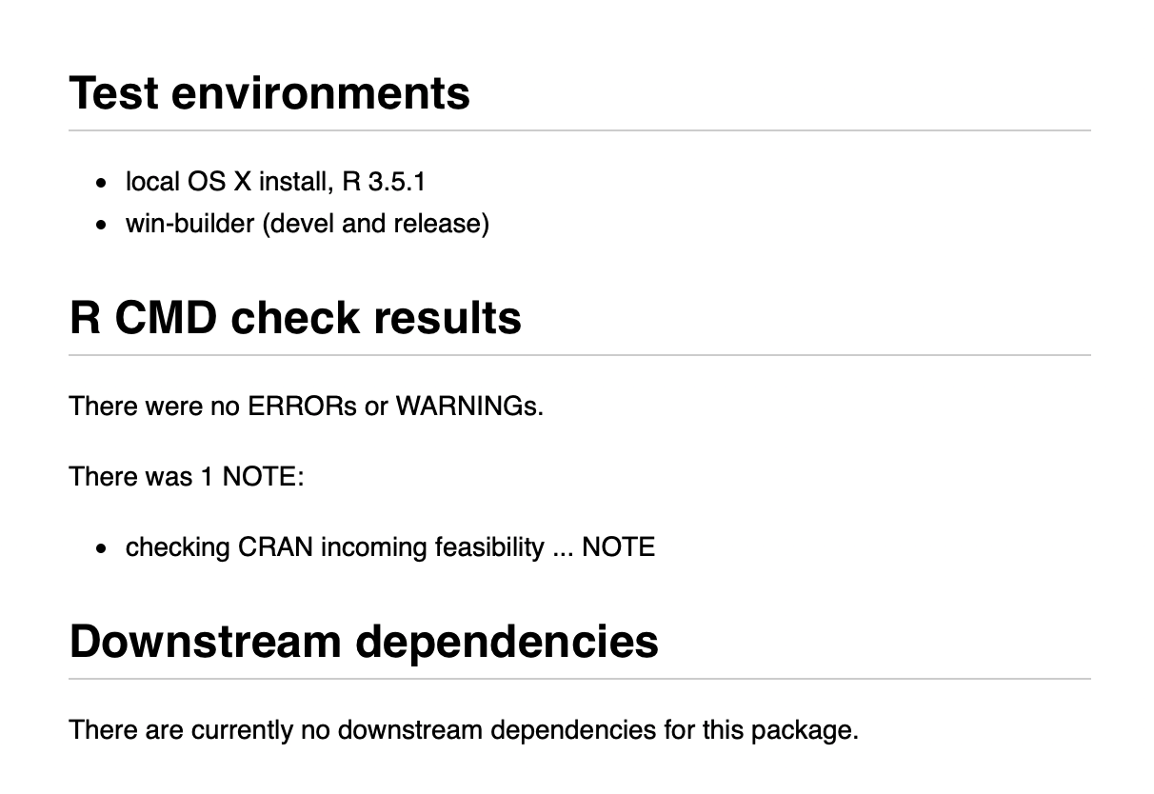
Output from R CMD check

Slide 58
Re-submission
Re-submission is done in the same way as submission
‘Optional comment’ field on the webform (and not a separate email) explaining how the feedback on previous submission(s) has been addressed.

